Slide 1
Chapter 4: Document Databases

Slide 2
JSON (JavaScript Object Notation) Databases
In a JSON document database:
A document is the basic unit of storage, corresponding approximately to a row in an RDBMS. A document comprises one or more key-value pairs, and may also contain nested documents and arrays. Arrays may also contain documents, allowing for a complex hierarchical structure.
A collection or data bucket is a set of documents sharing some common purpose; this is roughly equivalent to a relational table. The documents in a collection don’t have to be of the same type, though it is typical for documents in a collection to represent a common category of information.

Slide 3
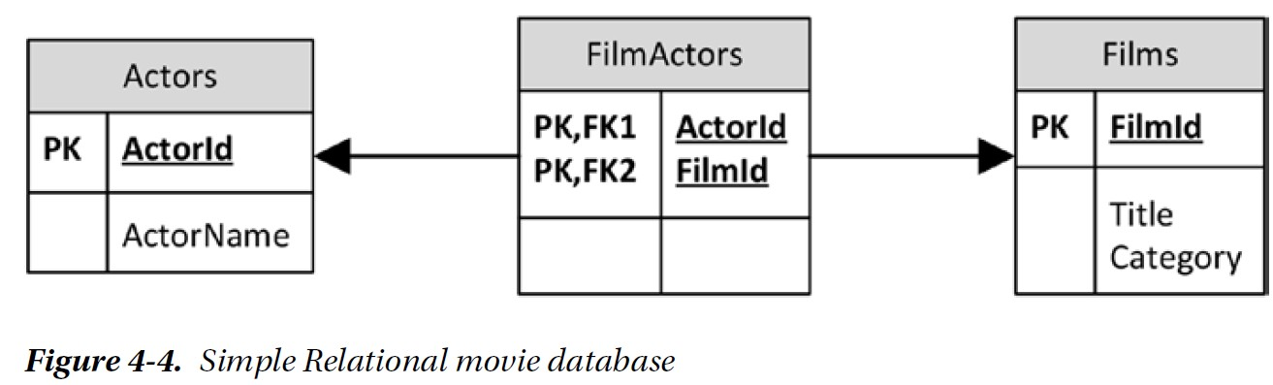
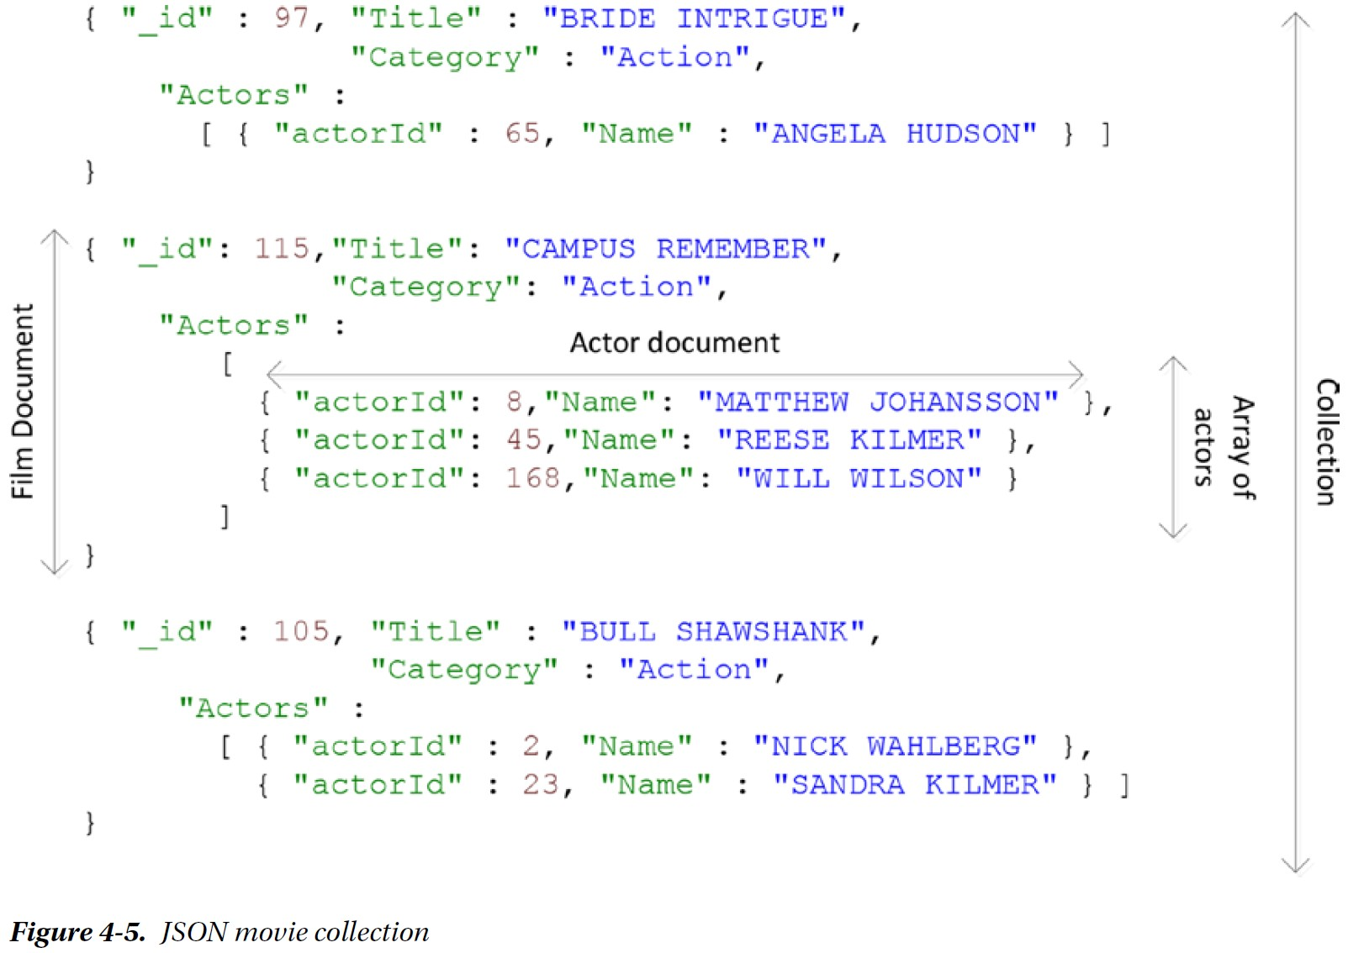
“Actors” are nested as an array within the “films” documents. This pattern is known as document embedding, allowing a film and all its actors to be retrieved in a single operation, and avoiding the need to perform joins within the application code.
This approach results in “actors” being duplicated across multiple documents, which could lead to inconsistencies if any of the “actor” attributes need to be changed.

Slide 4
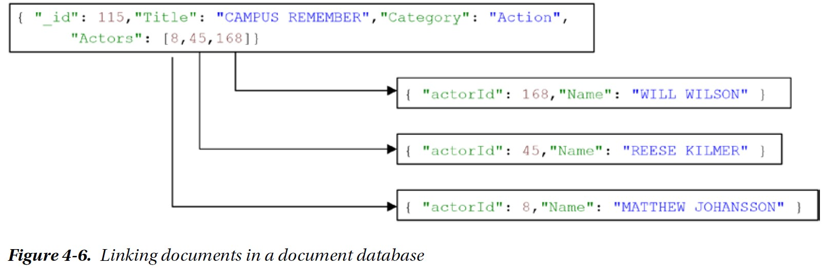
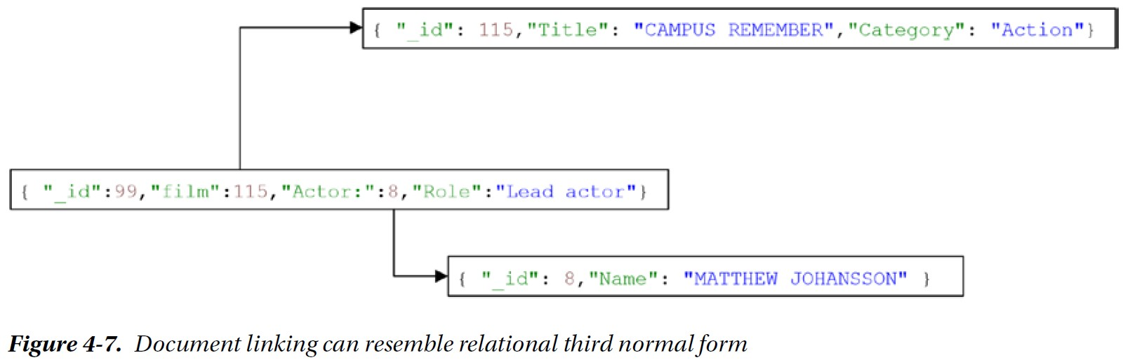

Slide 5
Early JSON Databases
CouchDB from CouchOne was the first notable JSON-based database system.
Membase was another nonrelational system, providing a persistent variation on the extremely popular Memcached framework.
Merger between Membase and CouchOne created CouchBase.
Couchbase 4.0 introduced a SQL-like layer for document access called N1QL (Non-first Normal Form Query Language).
MongoDB is a JSON-oriented document database. It supports for data types such as dates and binary data. MongoDB provides a JavaScript-based query capability that is reasonably easy to learn (see Figure 4-8 on the next slide).

Slide 6
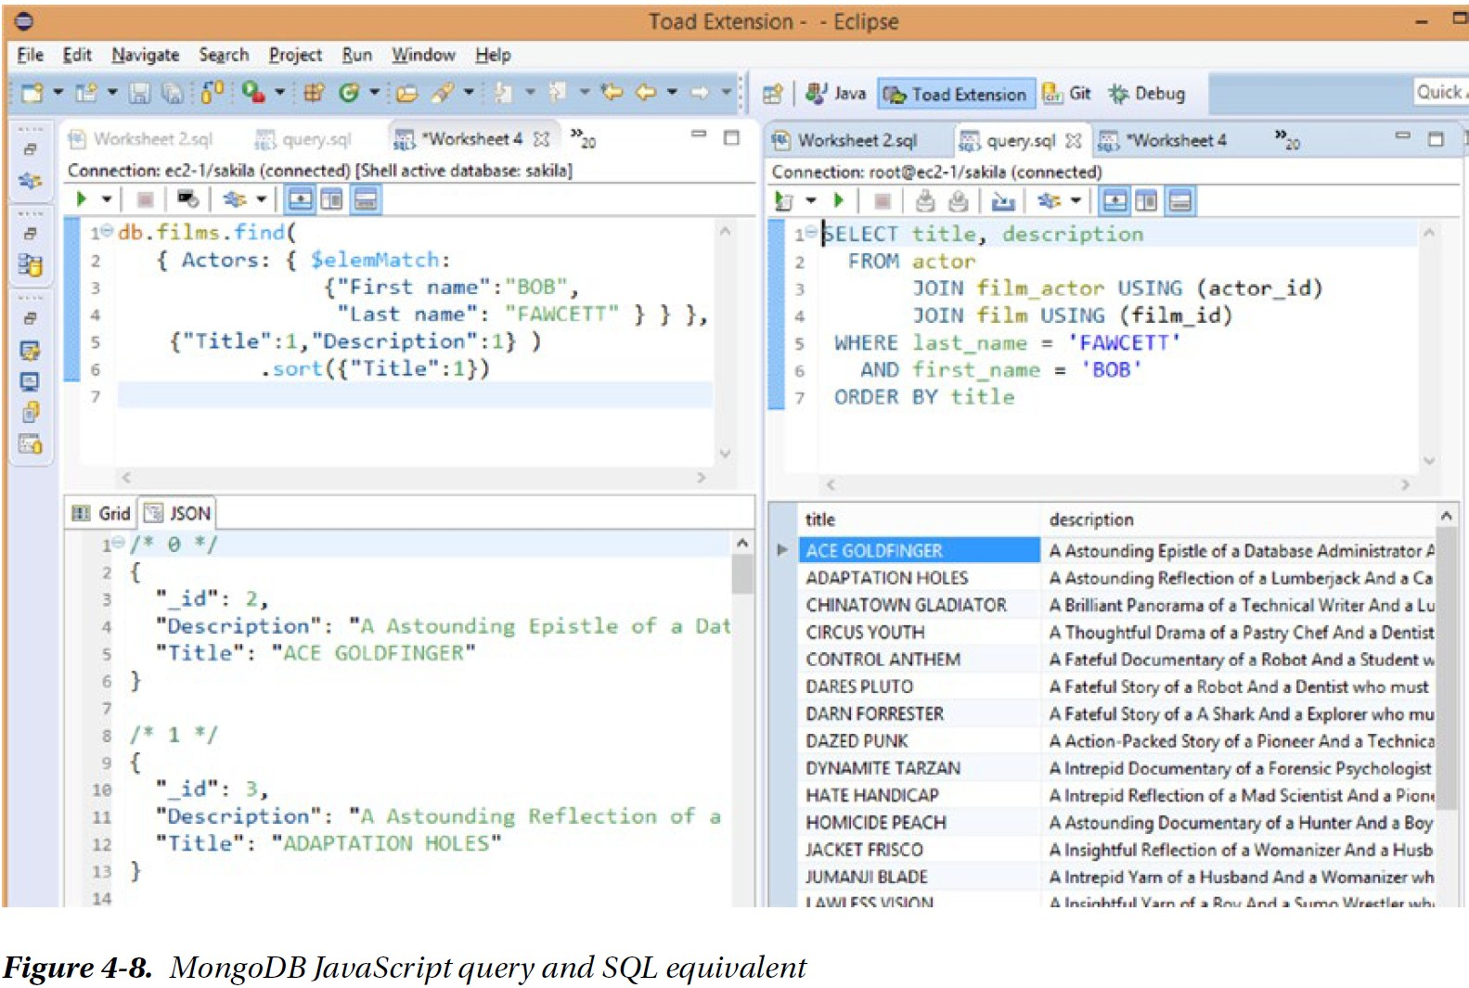

Slide 7
Chapter 6: Columnar Databases

Slide 8
Data Warehousing Schemas
To maintain service-level response times for the OLTP systems, we separate OLTP and OLAP workloads.
Star schemas were developed to create data warehouses in which aggregate queries could execute quickly and which would provide a predictable schema for Business Intelligence (BI) tools.
Despite indexing and SQL optimization schemes to accelerate queries against star schemas, processing queries in data warehouses remained CPU and IO intensive, degrading data warehousing performance.
Alternatives: Columnar databases, including Sybase IQ, Vertica, InfoBright, VectorWise, MonetDB, and SAP HANA.

Slide 9
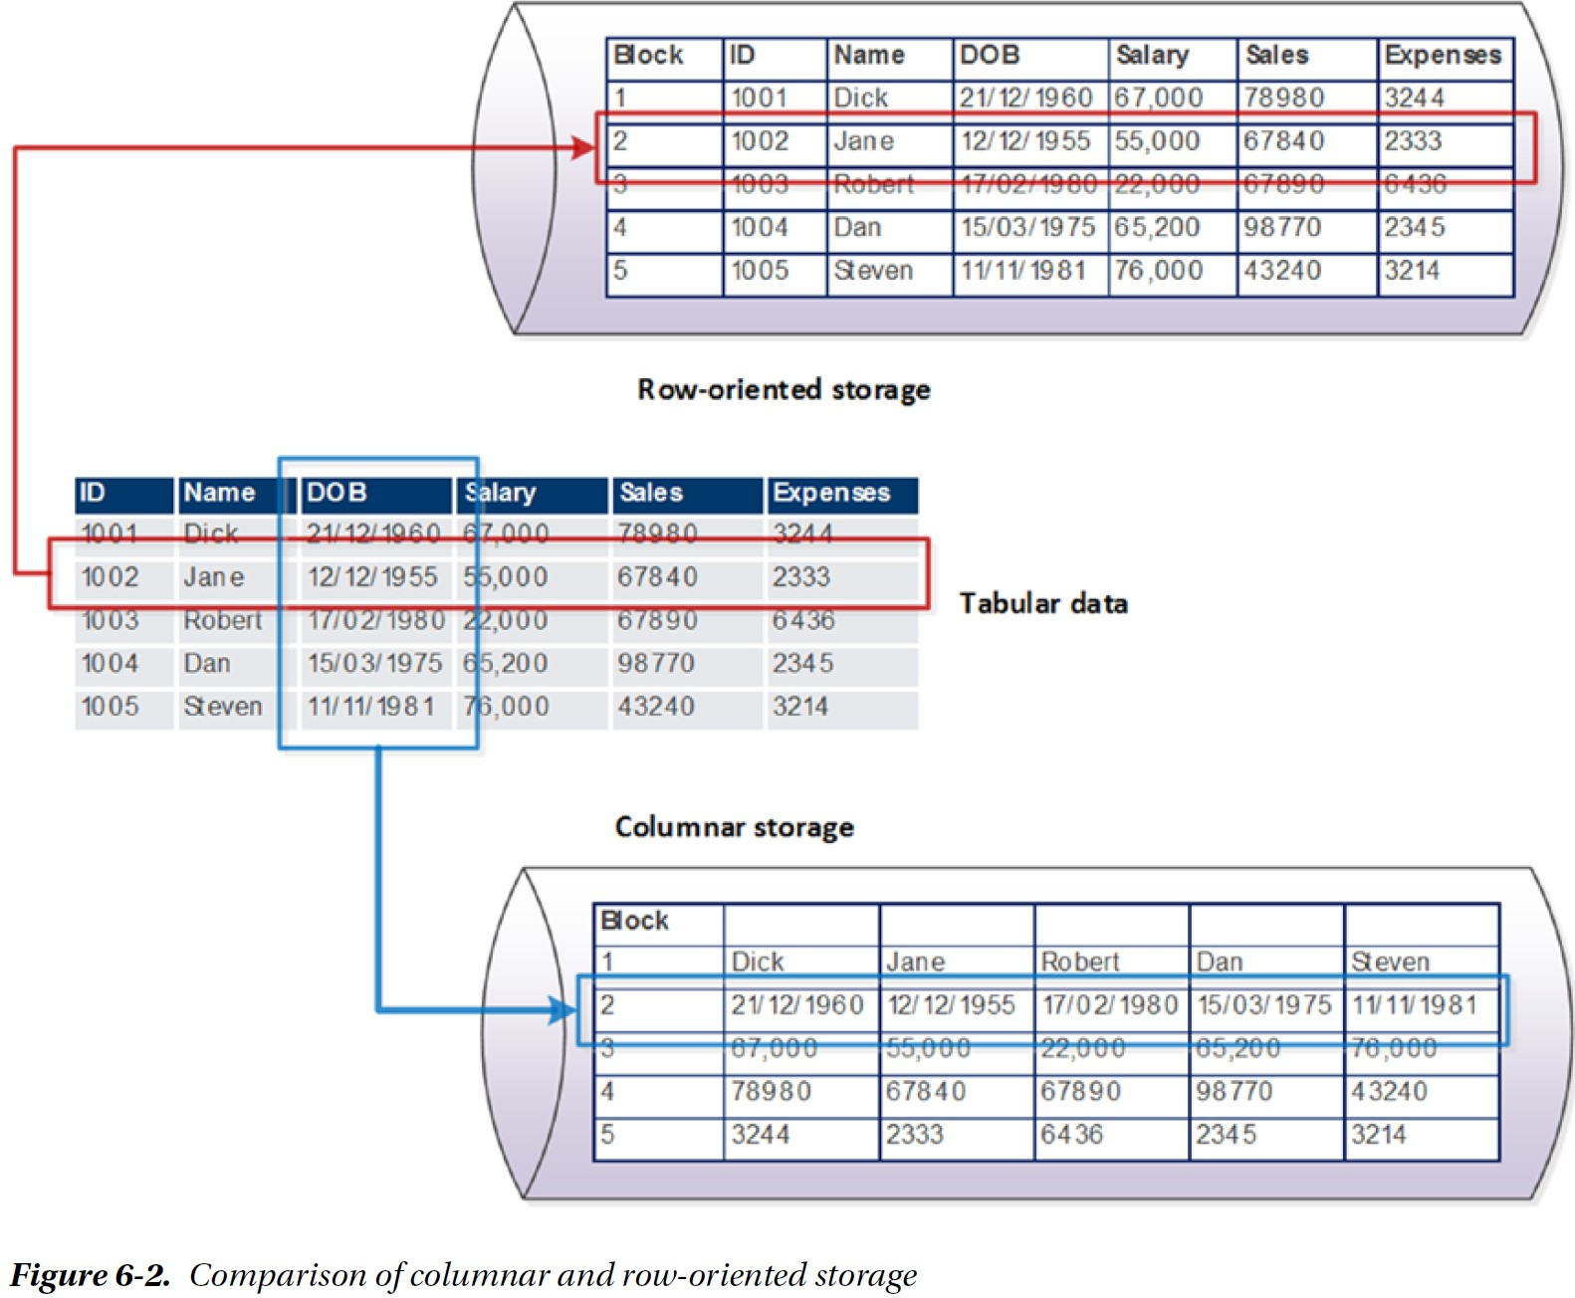
Columnar Database

Slide 10
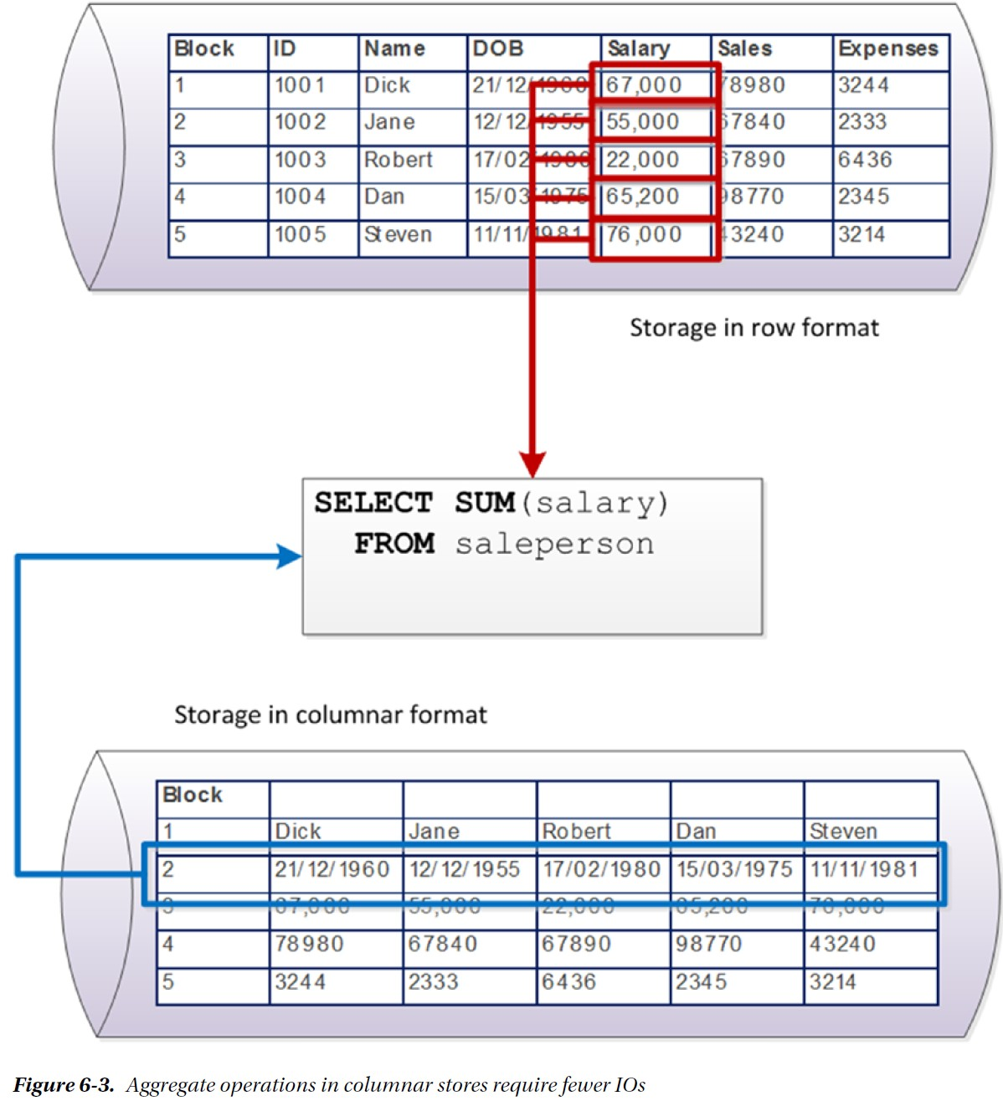
Columnar Database (continued)
First advantage: in a columnar architecture, queries that seek to aggregate the values of specific columns are optimized, because all of the values to be aggregated exist within the same disk blocks.
Second advantage: compression.
In many cases a columnar database stores column data in a sorted order. In this case, very high compression ratios can be achieved with very low
computational overhead.

Slide 11
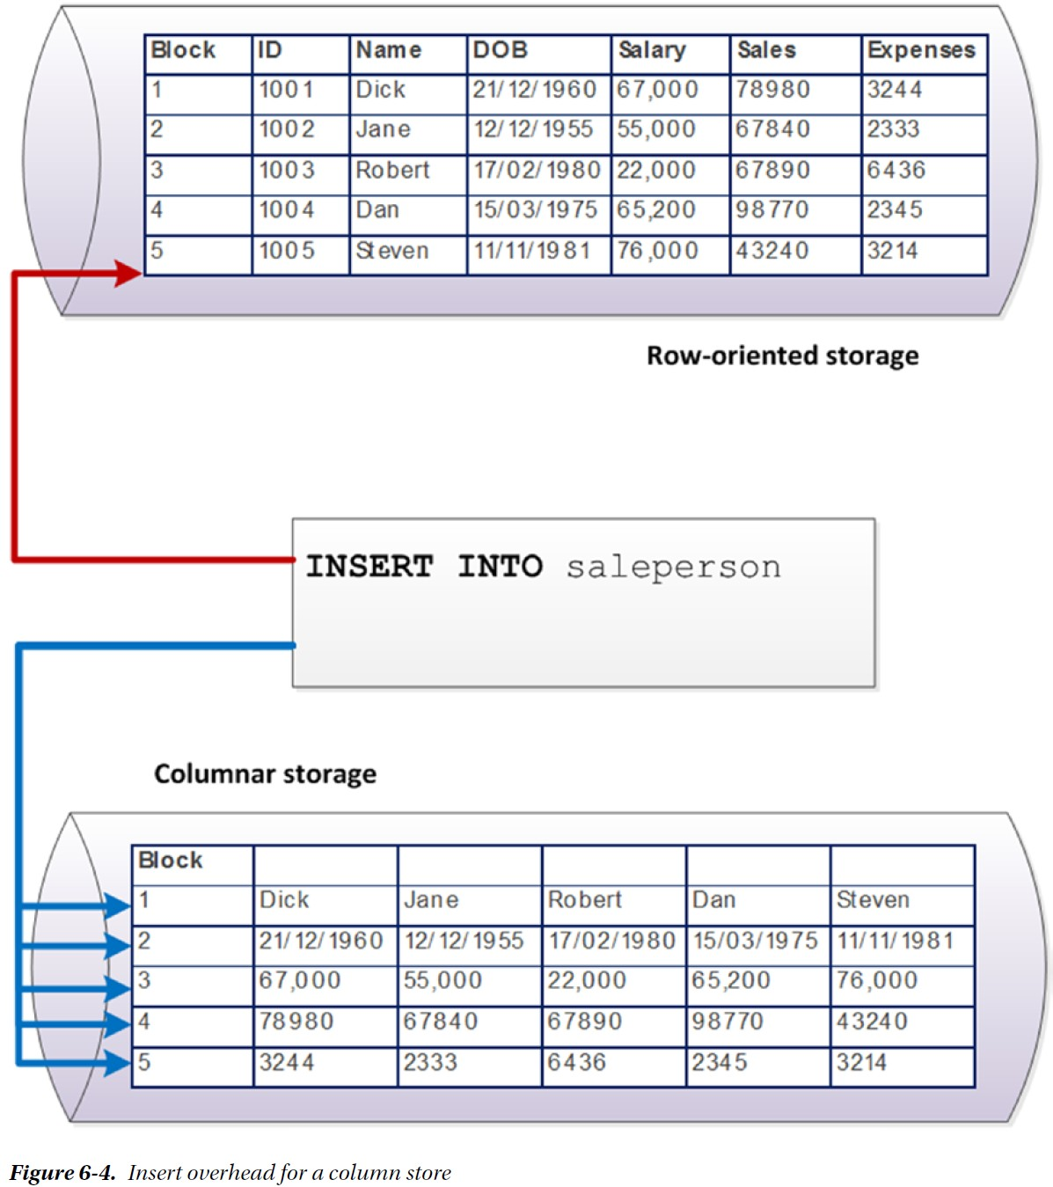
Columnar Database (continued)
The key disadvantage of the columnar architecture — and the reason it is a poor choice for OLTP databases — is
the overhead it imposes on single row operations. In a columnar database, retrieving a single row involves
assembling the row from each of the column stores for that table.

Slide 12
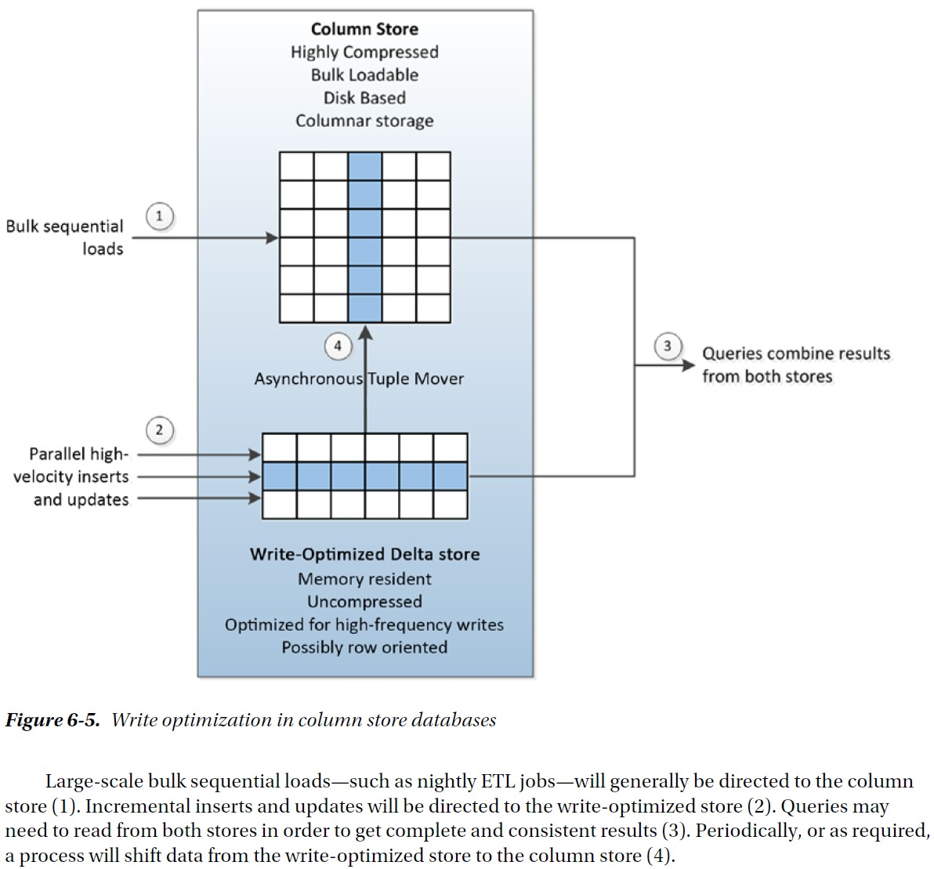
Column Database Architectures

Slide 13
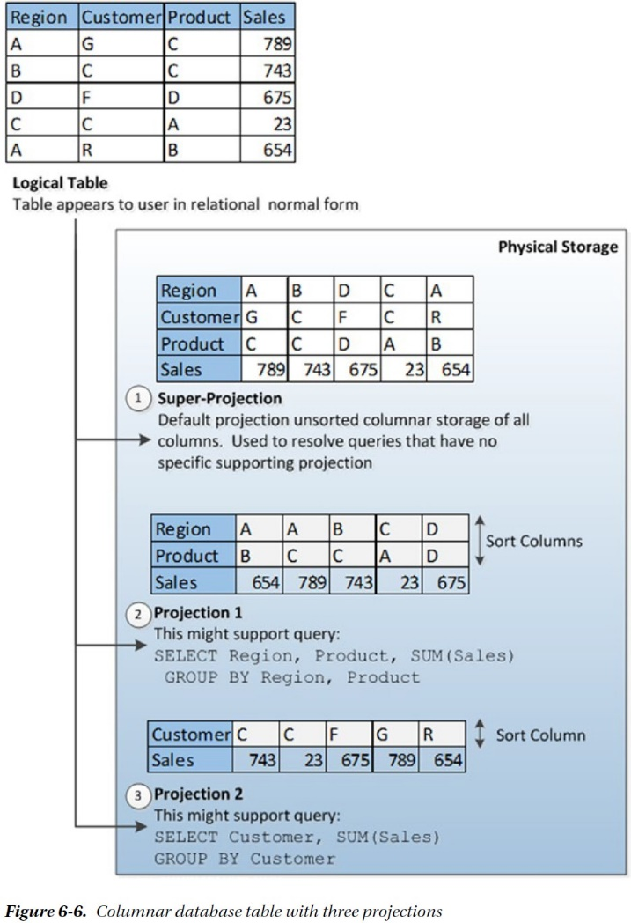
Projections in Columnar Databases
In Vertica, projections may be sorted on one or more columns. This decreases processing time for sort and aggregate operations, and also increases compression efficiency.

Slide 14
Chapter 7 The End of Disk? SSD and In-Memory Databases

Slide 15
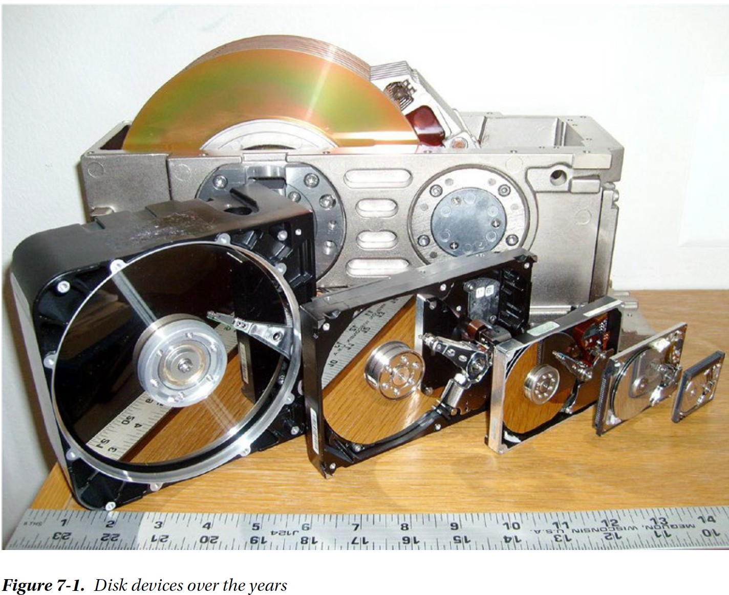
The End of Disk?
While Moore’s law drives exponential growth in CPU, memory, and disk density, it does not apply to the mechanical aspects of disk performance. Consequently, magnetic disks have become an increasing drag on database performance.

Slide 16
Solid State Disk
No moving parts
Provide tremendously lower IO latencies.
Performance of flash SSD is on orders of magnitude superior to magnetic disk devices, especially for read operations.
A random read from a high-end solid state disk may complete in as little as 25 microseconds, while a read from a magnetic disk may take up to 4,000 microseconds—over 150 times slower.
However, the speed improvement is not proportionate for all workloads. In particular, it takes longer to modify information in an SSD than to read from it (see next slide).

Slide 17
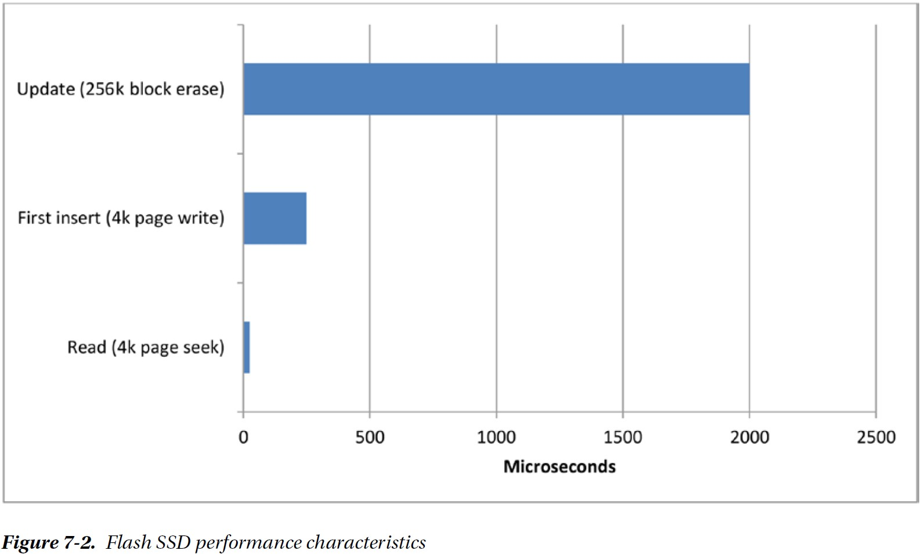
Flash Disk Performance Characterisitcs

Slide 18
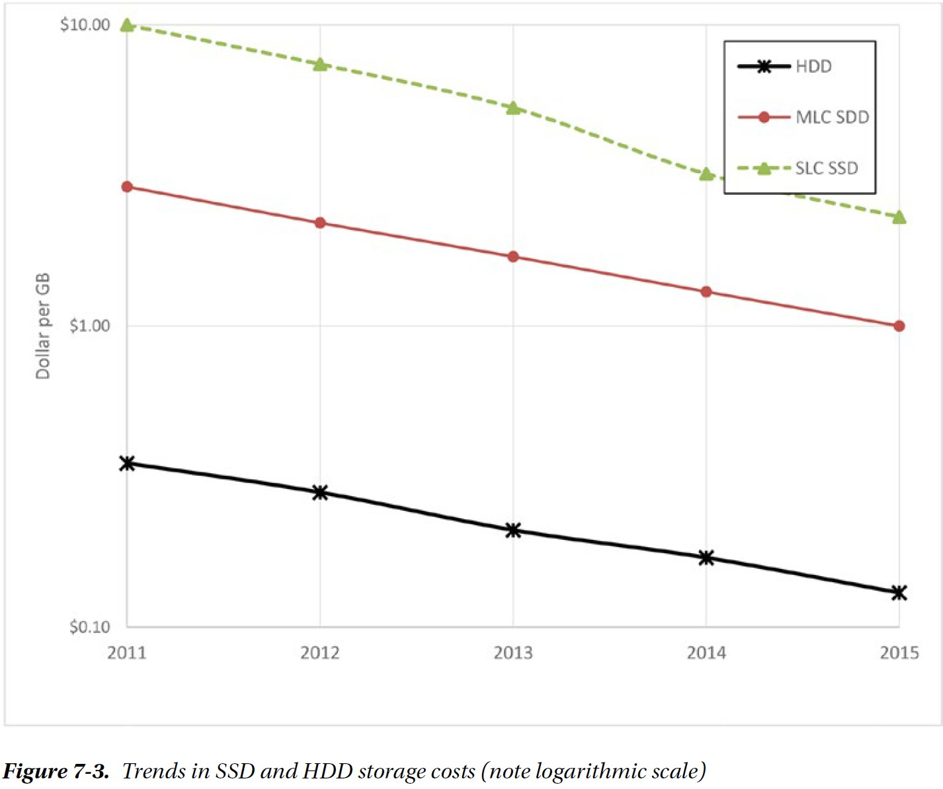
The Economics of Disks
While SSD continues to be an increasingly economic solution for small databases or for
performance-critical systems, it is unlikely to become a universal solution for massive databases, especially for data that is infrequently accessed.
We are, therefore, likely to see combinations of solid state disk, traditional hard drives, and memory providing the foundation for next-generation databases.

Slide 19
SSD-Enabled Databases
Aerospike is a NoSQL database that attempts to provide a database architecture that can fully exploit the IO characteristics of flash SSD.
Aerospike implements a log-structured file system: updates are physically implemented by appending the new value to the file and marking the original data as invalid. The storage for the older values are recovered by a background process at a later time.
Moreover, rather than using main memory as a cache to avoid physical disk IO, Aerospike uses main memory to store indexes to the data while keeping the data always on flash.
Cassandra also utilizes log-structured file system.

Slide 20
In-Memory Databases
The solid state disk has resulted in only incremental changes for most database architectures.
A more paradigm-shifting trend has been the increasing practicality of storing complete databases in main memory.
This is due to exponential improvements in the cost of memory and the amount of memory that can be stored on a server since the earliest days of computing (see next slide)

Slide 21
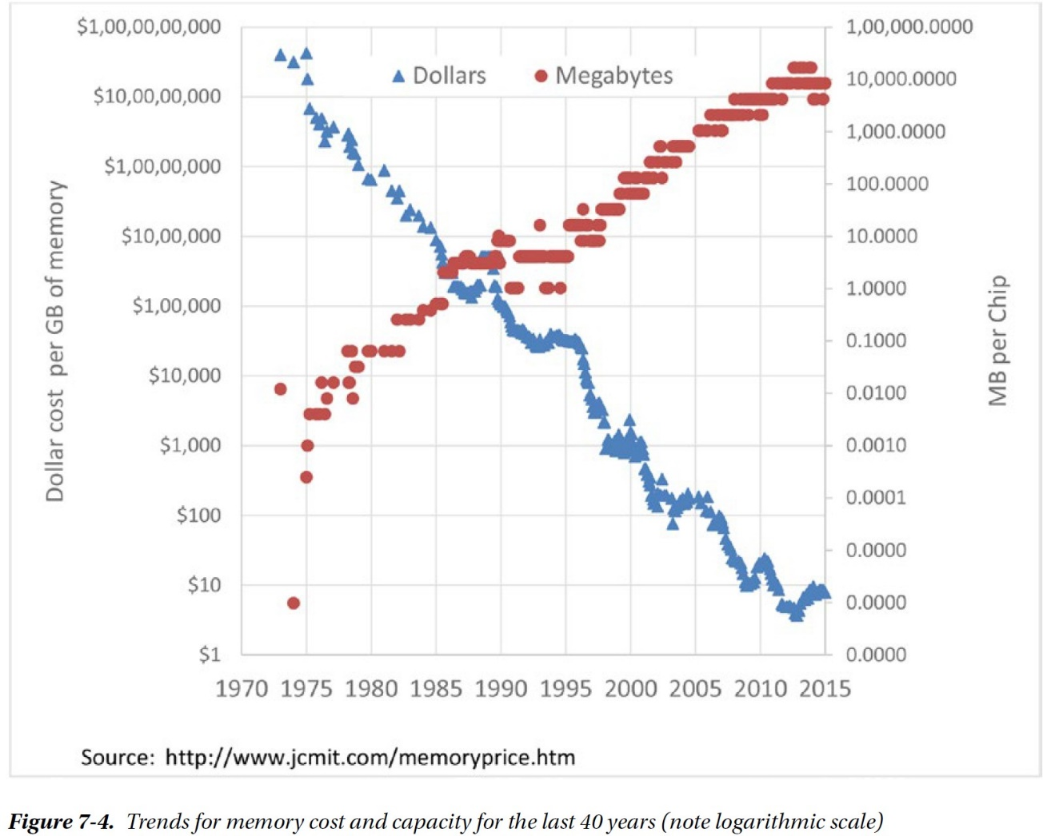
Trends for Memory Cost and Capacity

Slide 22
In-Memory Databases (continued)
There are two changes to traditional database architecture an in-memory system should address:
Cache-less architecture: Traditional disk-based databases almost invariably cache data in main memory to minimize disk IO. This is counterproductive in an in-memory system.
Alternative persistence model: Data in memory disappears when the power is turned off, so the database must apply some alternative mechanism for ensuring that no data loss occurs:
Replicating data to other members of a cluster.
Writing complete database images (called snapshots or checkpoints) to disk files.
Writing out transaction/operation records to an append-only disk file (called a transaction log or journal).

Slide 23
In-Memory Databases (continued)
TimesTen is an in-memory database system that aspires to support workloads similar to a traditional relational system, but with better performance.
When the database is started, all data is loaded from checkpoint files into main memory.
The application interacts with TimesTen via SQL requests that arguaranteed to find all relevant data inside that main memory.
Periodically or when required database data is written to checkpoint files.
An application commit triggers a write to the transaction log, though by default this write will be asynchronous so that the application will not need to wait on disk.
The transaction log can be used to recover the database in the event of failure.

Slide 24
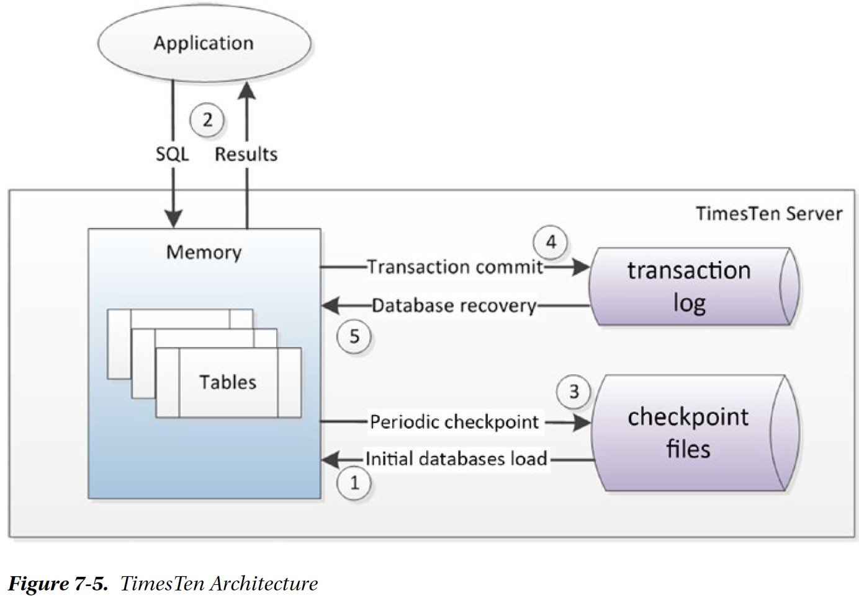
TimesTen Architecture

Slide 25
In-Memory Databases (continued)
Redis (Remote Dictionary Server)
While TimesTen is an attempt to build an RDBMS compatible in-memory database, Redis is essentially an in-memory key-value store.
Redis uses disk files for persistence:
The Snapshot files store copies of the entire Redis system at a point in time.
Snapshots can be created on demand or can be configured to occur at scheduled intervals.
A snapshot also occurs when the server is shut down.
The Append Only File (AOF) keeps a journal of changes that can be used to “roll forward” the database from a snapshot in the event of a failure.
Redis is popular among developers as a simple, high-performance key-value store that performs well without expensive hardware.
It lacks the sophistication of some other nonrelational systems such as MongoDB.

Slide 26
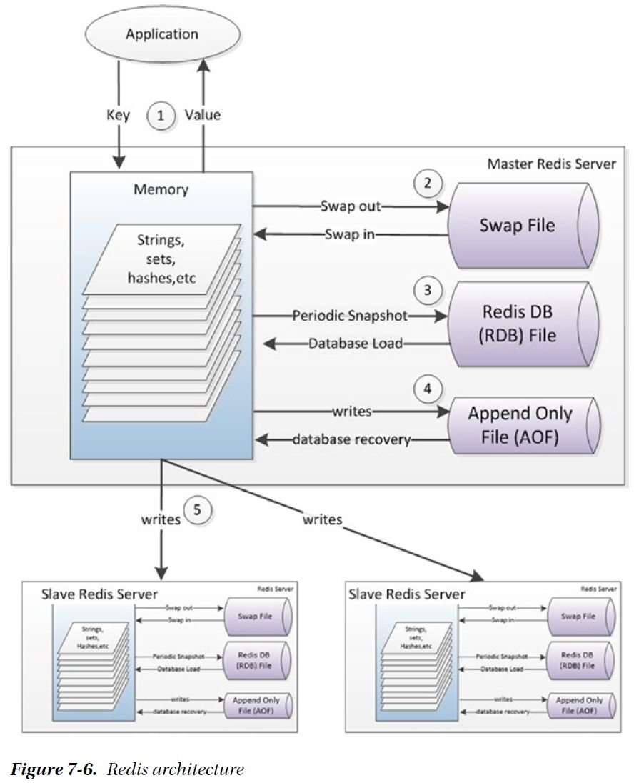
Redis Architecture
The application interacts with Redis through primary key lookups that return “values” —strings, sets of strings, hashes of strings, etc.
The key values will almost always be in memory, though it is possible to configure Redis with a virtual memory system, in which case key values may have to be swapped in or out.
Periodically, Redis may dump a copy of the entire memory space to disk.
Redis can be configured to write changes to an append-only journal file either at short intervals or after every operation.
Redis may replicate the state of the master database asynchronously to slave Redis servers.

Slide 27
In-Memory Databases (continued)
SAP HANA
SAP introduced HANA in 2010, positioning it as a revolutionary in-memory database designed primary for Business Intelligence (BI), but also capable of supporting OLTP workloads.
SAP HANA is a relational database designed to provide high performance by combining in-memory technology with a columnar storage option, installed on an optimized hardware configuration.
Tables in HANA can be configured for row-oriented or columnar storage. Typically, tables intended for BI purposes would be configured as columnar, while OLTP tables are configured as row oriented.
The choice of row or columnar formats provides HANA with its ability to provide support for both OLTP and analytic workloads.

Slide 28
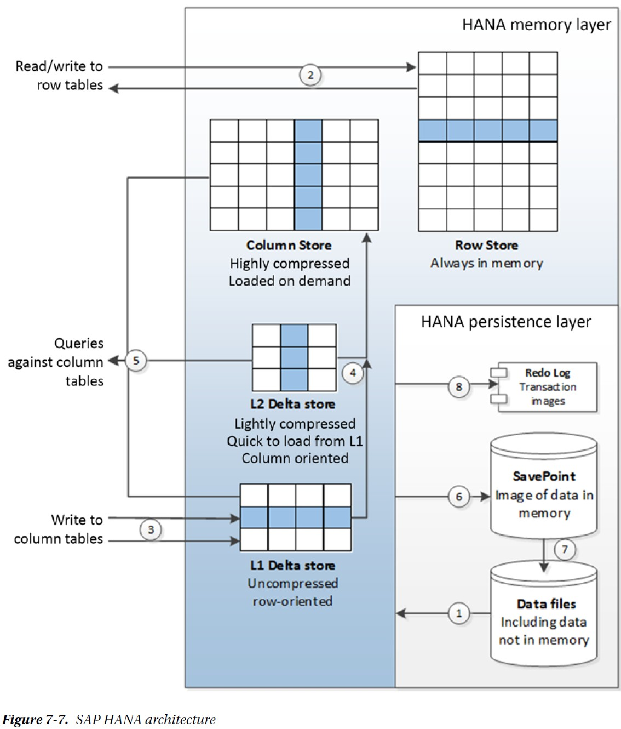
SAP HANA Architecture
On start-up, row-based tables and selected column tables are loaded from the database files.
Other column tables will be loaded on demand. Reads and writes to row-oriented tables can be applied directly.
Updates to column-based tables will be buffered in the delta store.
Initially to the L1 row-oriented store. Data in the L1 store will consequently be promoted to the L2 store, and finally to the column store itself.
Queries against column tables must read from both the delta store and the main column store.
Images of memory are copied to save points periodically.
These save points are merged with the data files in due course.
When a commit occurs, a transaction record is written to the redo log.

Slide 29
In-Memory Databases (continued)
VoltDB
VoltDB is a commercial implementation of the H-store design, which describes an in-memory database designed with the explicit intention of not requiring disk IO during normal transactional operations — it aspires to be a pure in-memory solution.
Applications that use Redis, HANA, and TimesTen still often need to wait for disk IO. In particular, there will often be a disk IO to some form of journal or transaction log when a transaction commits.

Slide 30
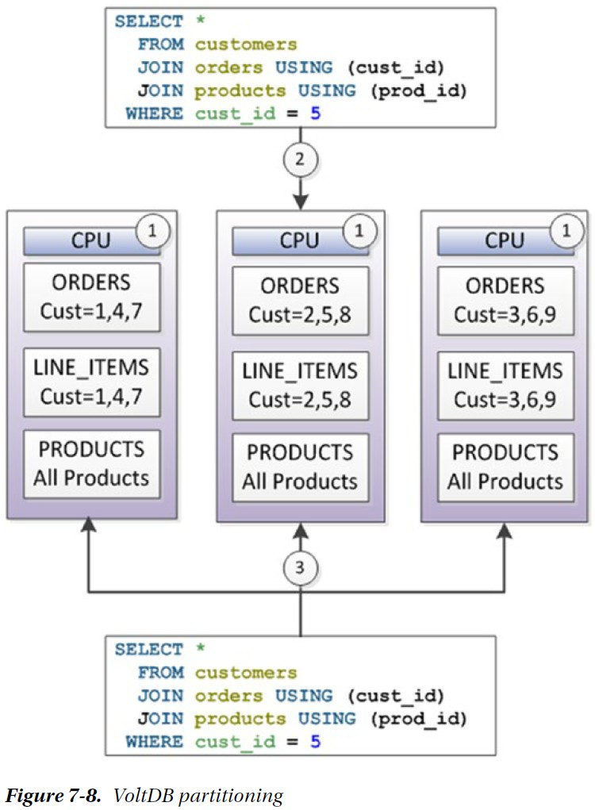
VoltDB Partitioning
Each partition is associated with a single CPU core, and only one SQL statement will ever be active against the partition at any given moment.
In this example, ORDERS and CUSTOMERS have been partitioned using the customer ID, while the PRODUCTS table is replicated in its entirety in all partitions. A query that accesses data for a single customer need involve only a single partition.
While a query that works across customers must access—exclusively, albeit for a short time—all partitions.

Slide 31
In-Memory Databases (continued)
Oracle RDBMS version 12.1 introduced the “Oracle database in-memory” feature.
Potentially misleading, since the database as a whole is not held in memory. Rather, Oracle has implemented an in-memory column store to supplement its disk-based row store.
Next slide illustrates the essential elements of the Oracle in-memory column store architecture.

Slide 32
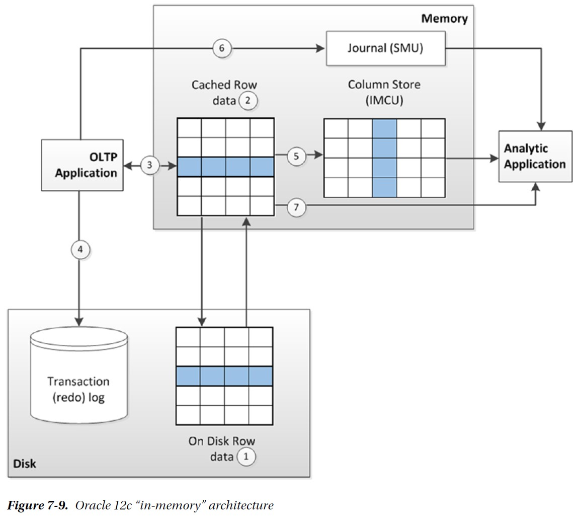
Oracle 12c In-Memory Architecture
OLTP applications work with the database in the usual manner. Data is maintained in disk files
Data is also cached in memory.
An OLTP application primarily reads and writes from memory
but any committed transactions are written immediately to the transaction log on disk.
When required or as configured, row data is loaded into a columnar representation for use by analytic applications.
Any transactions that are committed once the data is loaded into columnar format are recorded in a journal.
Analytic queries will consult the journal to determine if they need to read updated data from the row store or possibly rebuild the columnar structure.

Slide 33
In-Memory Databases (continued)
Berkeley Data Analysis Stack (BDAS) consists of a few core components:
Spark is an in-memory, distributed, fault-tolerant processing framework. If SAP HANA and Oracle TimesTen represent in-memory variations on the relational database theme, and if Redis represents an in-memory variation on the key-value store theme, then Spark represents an in-memory variation on the Hadoop theme.
Mesos is a cluster management layer somewhat analogous to Hadoop’s YARN. Mesos is specifically intended to allow multiple frameworks, including BDAS and Hadoop, to share a cluster.
Tachyon is a fault-tolerant, Hadoop-compatible, memory-centric distributed file system. The file system allows for disk storage of large datasets, but promotes aggressive caching to provide memory-level response times for frequently accessed data.

Slide 34
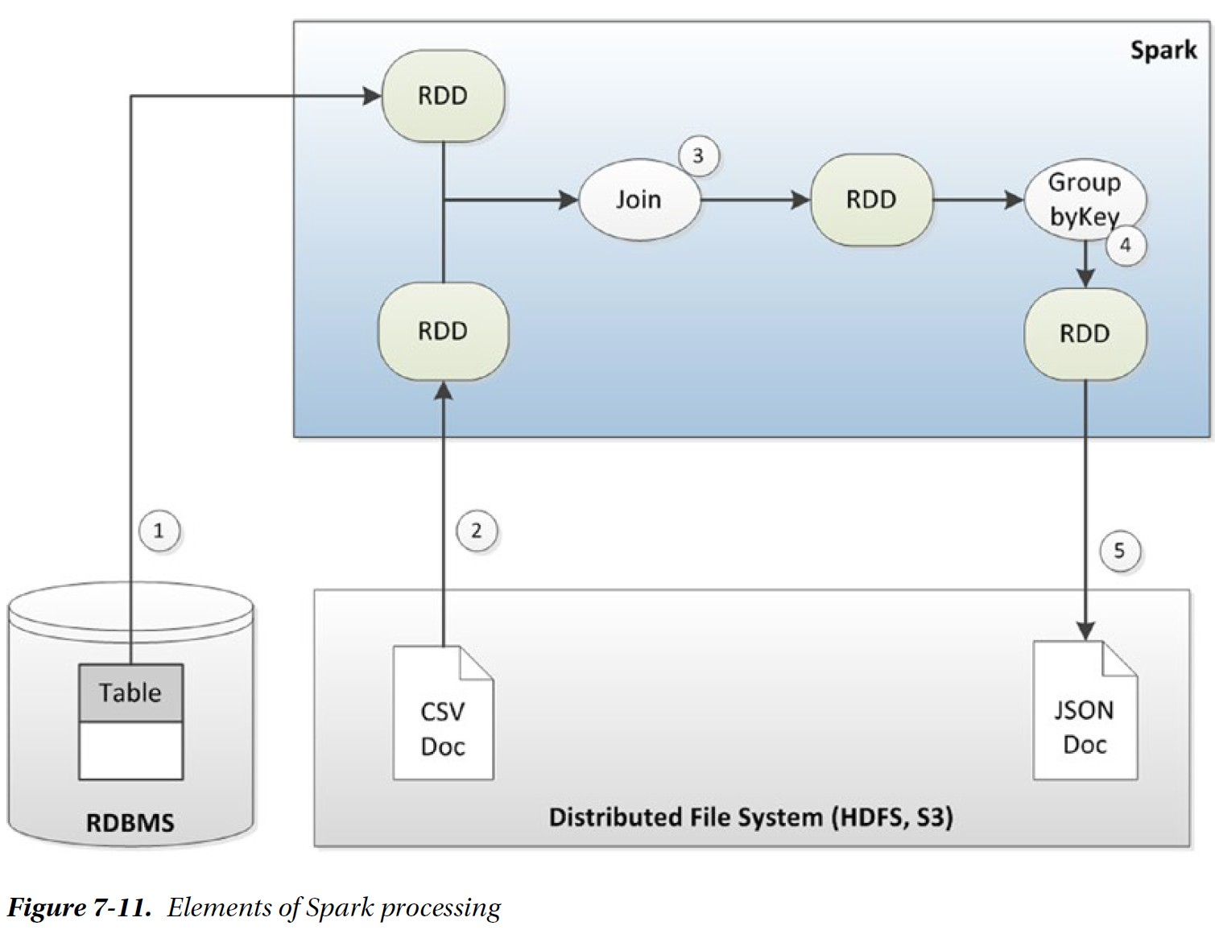
Elements of Spark Processing
Data can be loaded into resilient distributed datasets (RDD) from external sources including relational databases
Or from a distributed file system such as HDFS.
Spark provides high-level methods for operating on RDDs and which output new RDDs. These operations include joins.
Or aggregations.
Spark data may be persisted to disk in a variety of formats.

